Slide 1
Photorefractive Nonlinearity
Dynamic Holography

Slide 2
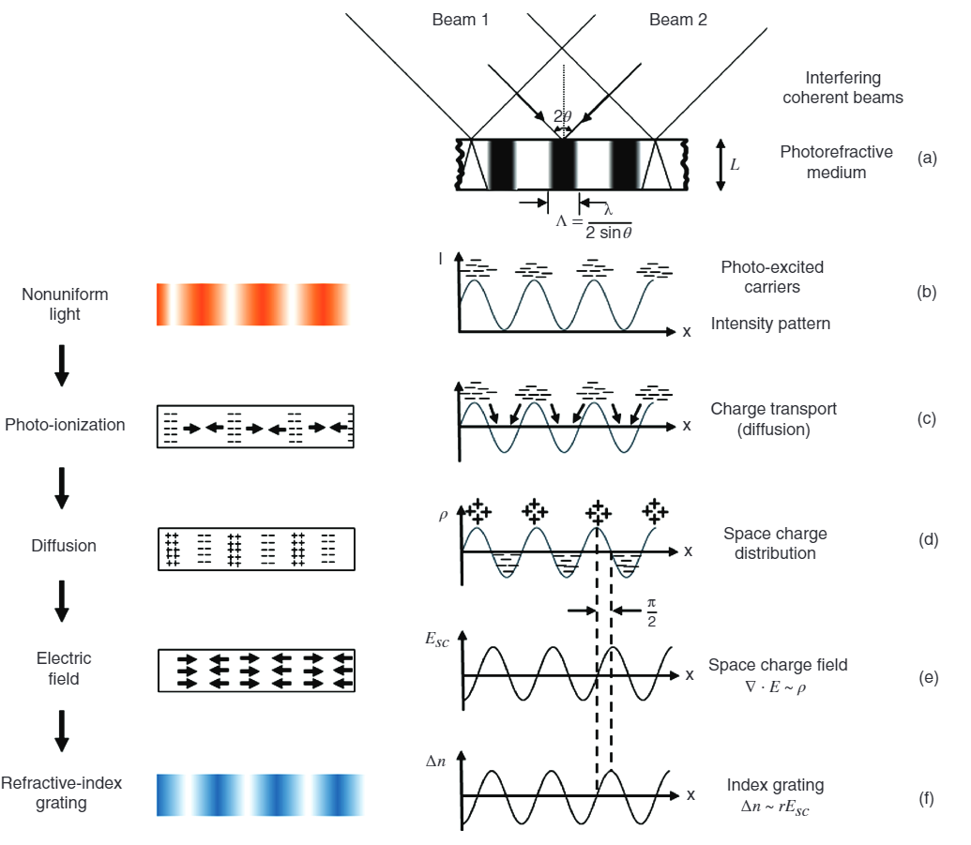
Courtesy of Marinova, et al. Wiley Encyclopedia of Electrical and Electronics Engineering, (2016)

Slide 3
Courtesy of Marinova, et al. Wiley Encyclopedia of Electrical and Electronics Engineering, (2016)

Slide 4
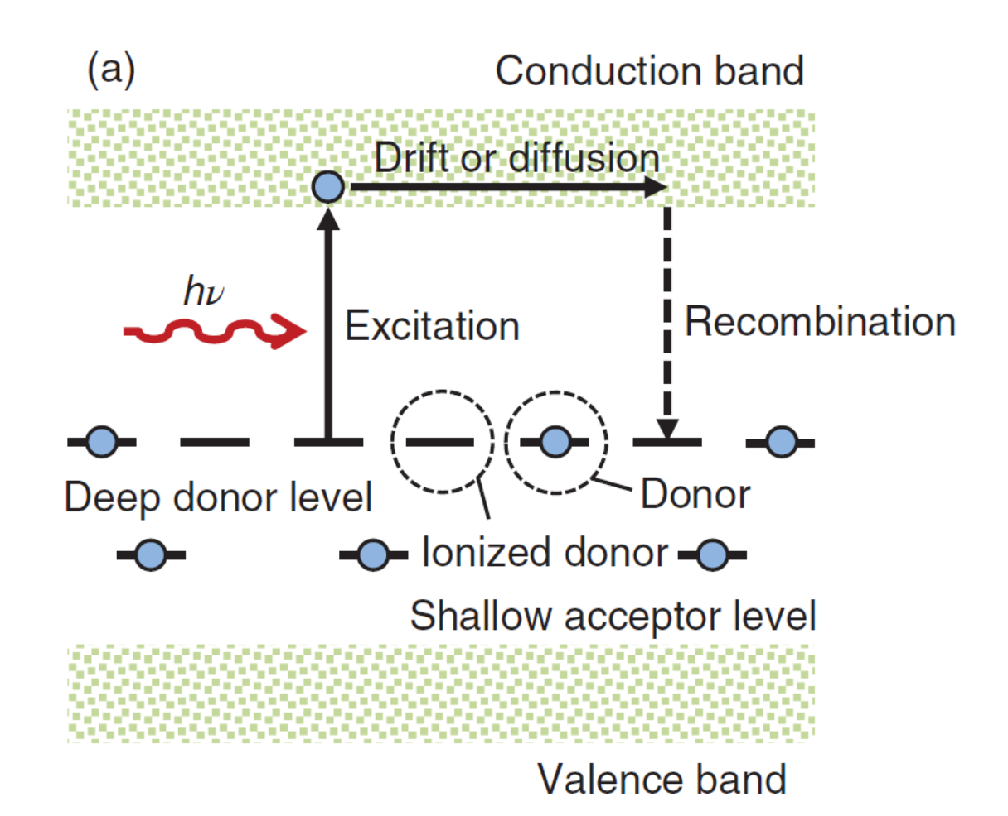
Photorefractive Equations of Kukhtarev et al. (1977)
Gain Coefficient

Slide 5
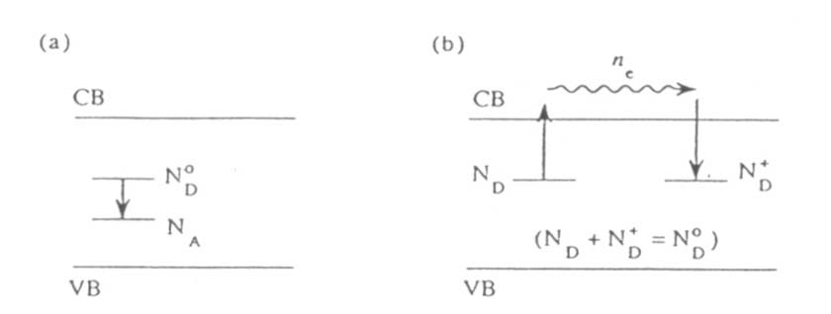
10.5 Photorefractive Equations of Kukhtarev et al.
Assume that the crystal contains N_{A} acceptors and N_{D}⁰ donors per unit volume, with N_{A}<<N_{D}⁰
Rate equations :
(10.5.1)
where, s : photoionization cross section of a donor
b : thermal generation rate (thermal ionization)
g : recombination coefficient
j : electrical current density
(10.5.2)
R. W. Boyd, 3rd ed.

Slide 6


Electrical current density :
(10.5.3)
where, m : electron mobility
D : Diffusion constant
j_{ph} : photovoltaic contribution to the current
Local field within the crystal :
$$ε_{dc}∇⋅E=−4πe(n_{e}+N_{A}−N_{D}^{+})$$
To Convert to SI:
Replace 4π with 1/ε₀
everywhere
(10.5.4)
Change in dielectric constant :
$$Δε=−ε^{2}γ_{eff}|E|$$
(10.5.5)
Wave equation for the optical field :
(10.5.6)
: Cannot easily be solved exactly

Slide 7
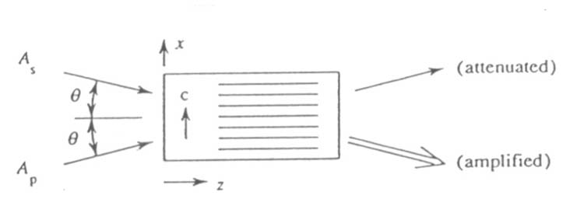
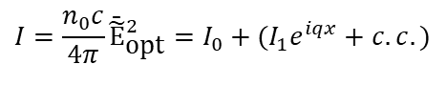
10.6 Two-Beam Coupling in Photorefractive Materials
Optical field within the crystal :
Intensity distribution of light within the crystal :
$$I=\frac{n_{0}c}{4π}{\bar{\tilde{E}}}_{\text{opt}}^{2}=I_{0}+(I_{1}e^{iqx}+c.c.)$$
where,
(10.6.2)
: grating wave vector

Slide 8
Intensity distribution of light within the crystal can also be described by
where,
: modulation index
Approximate steady-state solution (|I₁|<<I₀)
Put,
1) From x independent term,
Report
(10.6.5)

Slide 9
In most realistic case,
2) From e^{iqx} dependent term (assume E₀=0),
Report
: Einstein relation
where,
: diffusion field strength
: maximum space charge field

Slide 10
(10.6.8)
i) Quarter period shift of the index grating with respective to the intensity distribution
ii)
iii)
: depends also on grating vector q
Defining the optimum value of q maximizing the second factor as q_{opt},
can be adjusted
where,

Slide 11

1) Steady state
(10.6.2) and (10.6.8) ➔
where,
Nonlinear polarization :
Dielectric constant change :
$$P_{s}^{NL}=\frac{Δε∗}{4π}A_{p}e^{ik_{s}⋅r}=\frac{−iε^{2}γ_{eff}E_{m}}{4π}\frac{|A_{p}|^{2}A_{s}}{|A_{p}|^{2}+|A_{s}|^{2}}e^{ik_{s}⋅r} \\ P_{p}^{NL}=\frac{Δε}{4π}A_{s}e^{ik_{p}⋅r}=\frac{iε^{2}γ_{eff}E_{m}}{4π}\frac{|A_{s}|^{2}A_{p}}{|A_{p}|^{2}+|A_{s}|^{2}}e^{ik_{p}⋅r}$$
(10.6.16)

Slide 12
Wave equation (slow varying approx.) :
where,
Similarly,
: when G>0, I_{s} is amplified and I_{p} is attenuated

Slide 14
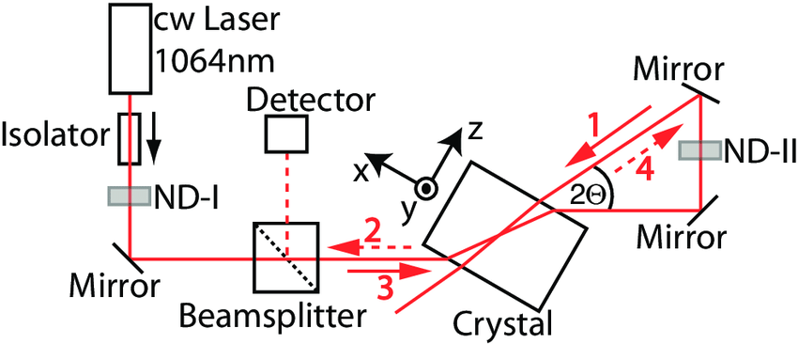
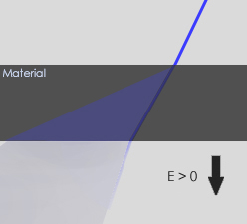
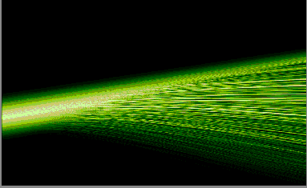
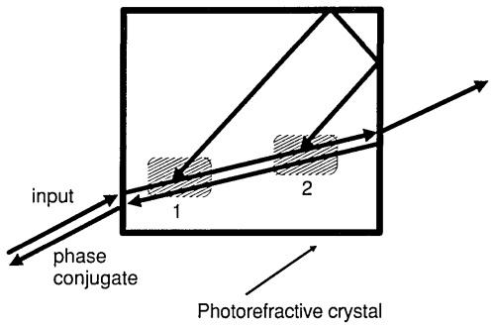
Beam Fanning

Slide 15
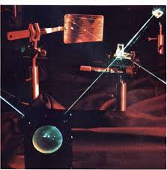
Spatula Laser!
Applications of Optical Phase Conjugation
David M. Pepper
Scientific American
Vol. 254, No. 1 (January 1986), pp. 74-83

